Slide 1





Launching and Positioning Haldiram’s in Switzerland
PRESENTED BY: POLY RABIDAS
RADHIKA AGARWAL
MOHSIN HASSAN

Slide 2

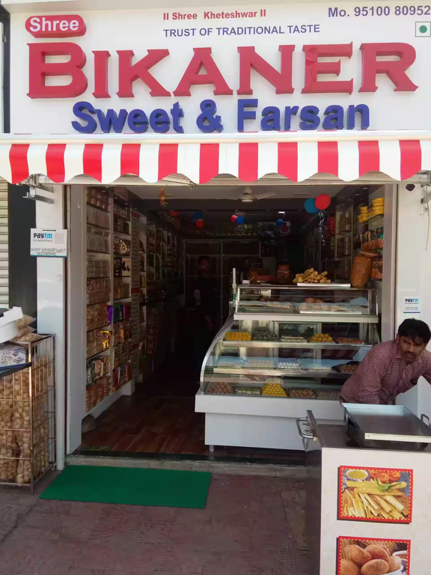


Humble beginnings: Starting from a single shop in Bikaner emphasizes the brand's grassroots origins and hard work.
Balancing tradition and innovation: This describes their ability to stay true to their heritage while adapting to changing preferences.
Diverse product range: Mentioning over 300 products showcases their vast offerings, catering to various tastes and needs.
Cultural significance: Highlighting the emotional connection and cultural aspect adds another dimension to their brand value.

Slide 3
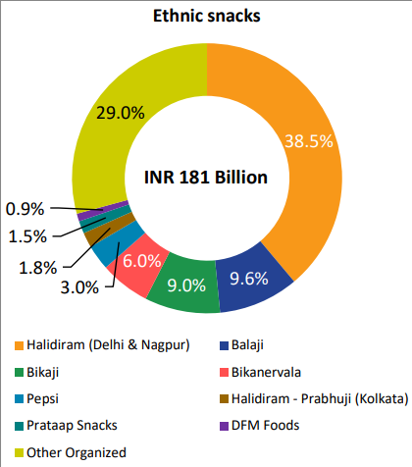
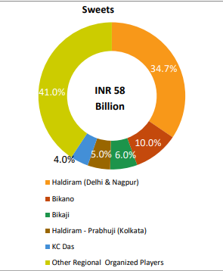

MARKET SHARE
Haldiram is the market leader in Ethnic Namkeen and snacks market has always been associated with packaged traditional snacks and sweets in India and abroad. With a long heritage it is expected to dominate the market over the next 4-5 years.
Source: https://www.bikaji.com/pub/media/Industry-Report-dated-30092022.pdf

Slide 4





COMPETITORS

Slide 5

Haldiram’s SWOT in India
S
W
STRENGTHS
WEAKNESSES
Strong Brand Presence
Diverse product range
Loyal customer base
Limited International Presence
Price Sensitivity
O
T
OPPORTUNITIES
THREATS
Market Expansion
Hotel Business
Competition
Price Range

Slide 6
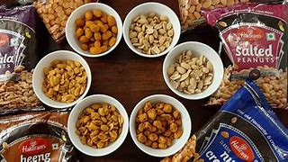

Haldiram's Success in India
1.Tradition Meets Innovation
2. Quality & Consistency
3. Strategic Branding
4. Operational Excellence
5. Market Savvy

Slide 7

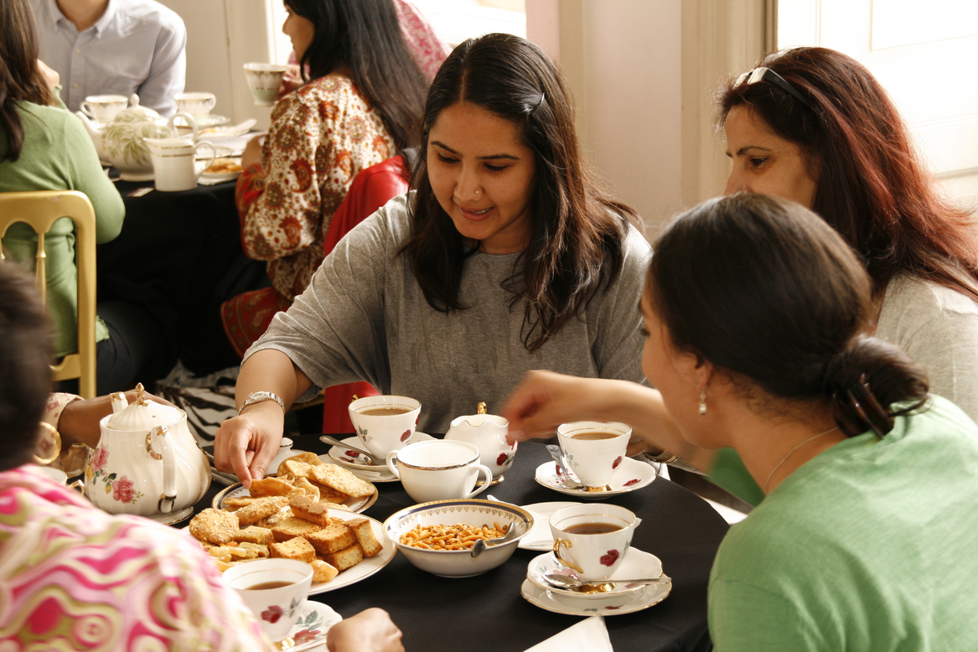

CULTURAL ASPECTS OF SUCCESS
Familiarity and Tradition
Festivals and Gifting
Vegetarian Options
Tea Time Ritual
Hospitality Symbol
Comfort Food Culture

Slide 8
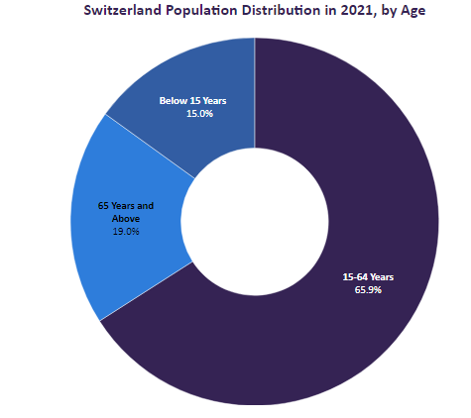
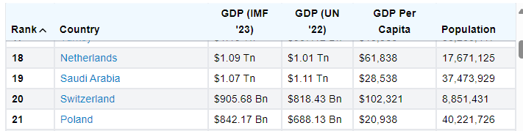

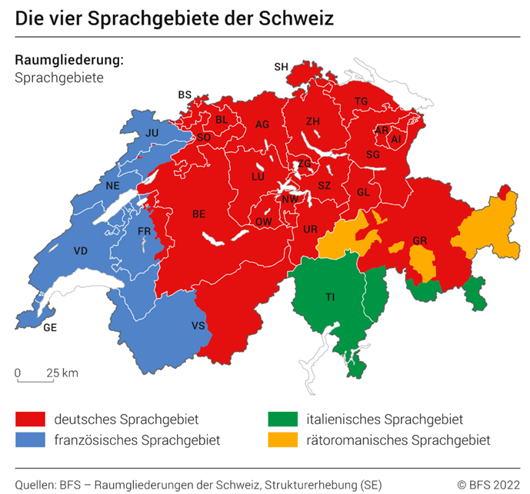
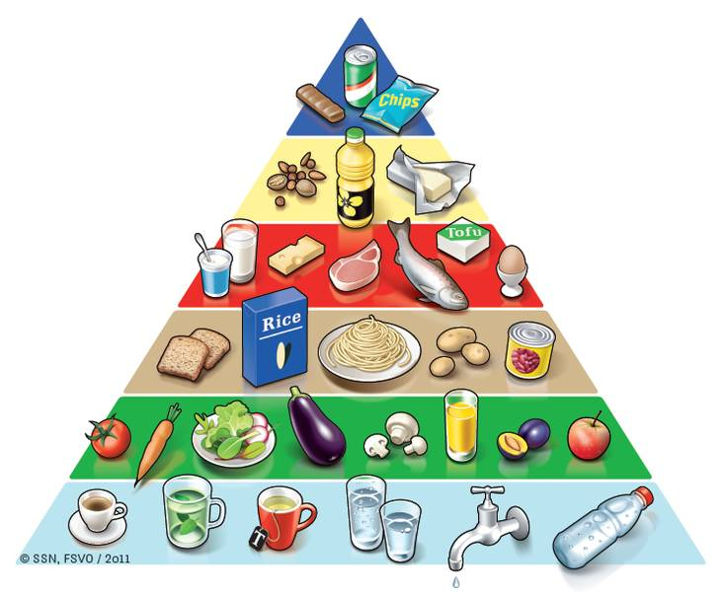
Switzerland Profile
The Swiss children’s nutrition disk.
The Swiss food pyramid.

Slide 9
Economics, Social, Legal and Political Environment
Economic:
High Purchasing Power: Based on World Bank data (2023), Switzerland's GDP per capita is approximately 87,080 USD, indicating a strong consumer base willing to pay for premium snacks.
Strong Currency: The Swiss Franc (CHF) is strong compared to the Indian Rupee (INR). The current exchange rate (as of April 23, 2024) is roughly 1 CHF ≈ 0.92 USD.
Political:
Trade Agreements: Trade agreements between India and Switzerland that benefit import process.
Political Stability: Switzerland enjoys high political stability, which minimizes risk of sudden policy changes that could affect our business.

Slide 10
Social:
Health-Conscious Consumers: Many Swiss consumers prioritize health and wellness.
Multicultural Society: Switzerland has a diverse population. Offering a variety of snack flavors or spice levels to cater to different preferences.
Transparency and Sustainability: Swiss consumers value transparency in sourcing and ethical production methods.
Legal:
Free Trade

Slide 11
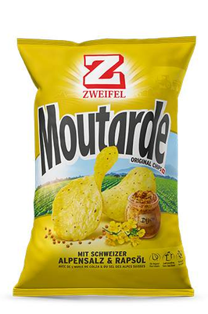
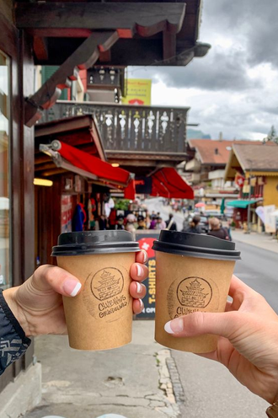
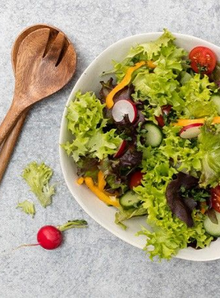
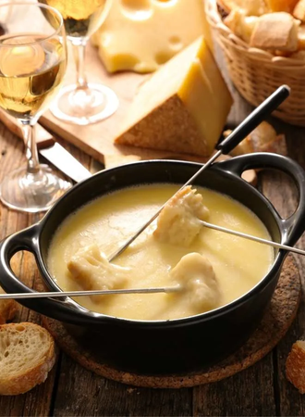
Cultural Analysis
Balance is Key
Time of Day
Swiss snacking enjoys a balance between sweet and savory options. Biberli (gingerbread) and Grittibänz (yeast figures) offer sweet indulgence, while Zweifel chips and nuts provide savory satisfaction.
sweet snacks are often enjoyed in the afternoon for a "Zvieri" (afternoon snack), while savory options might be chosen for on-the-go consumption.
Health & Quality
Cultural Nuances
Health consciousness is on the rise.
Quality Matters: Swiss consumers value quality ingredients and traditional production methods.
Health consciousness is on the rise.
Quality Matters: Swiss consumers value quality ingredients and traditional production methods.

Slide 12
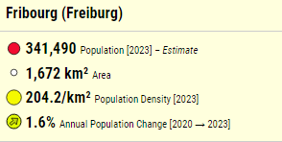
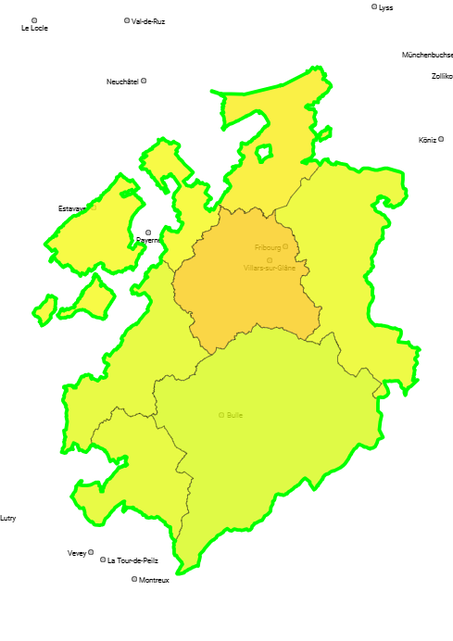
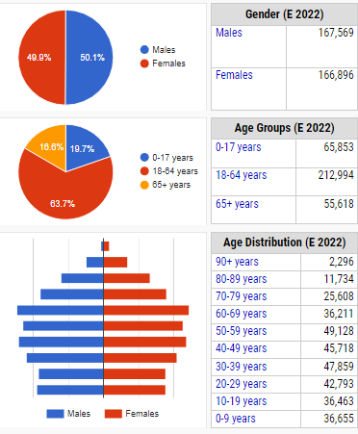
Fribourg

Slide 13



Target Market
Fribourg
Active Lifestyle
Age-13- 60years

Slide 14
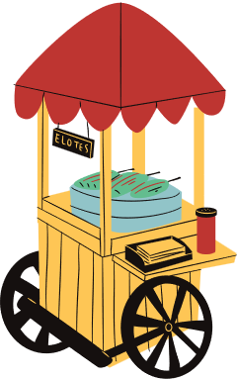

Market Potential
High Purchasing Power: Swiss consumers have a high disposable income, allowing them to afford premium-priced snacks like potentially imported Haldiram products. (1 franc = 91.45 Rupees)
Interest in Ethnic Flavors: The growing multicultural population in Switzerland might be receptive to the unique flavors offered by Haldiram snacks, especially if they cater to health-conscious preferences.
Snacking Culture: Switzerland has a well-established snacking culture, with consumers enjoying sweet and savory options throughout the day.

Slide 15
SWITZERLAND SWOT TARGET MARKET
Strengths Unique Flavors Heath conscious Options |  | Weaknesses Limited Brand Awareness Distribution Network Price Sensitivity
Opportunities Growing Snack Market Interest in Ethnic Flavors Premium Positioning |  | Threats Competition Strict Regulations Economic Fluctuations
S
W
S
O
T
Notes:
Strengths :
Unique Flavors: Haldiram offers a variety of snacks with distinct flavors and ingredients, potentially unseen in the Swiss market.
Brand Recognition: Haldiram is a well-established brand in India, potentially creating brand trust among the Indian
diaspora in Switzerland.
Health-Conscious Options: If Haldiram offers healthy snack options, it can cater to the growing health-conscious trend in Switzerland.
Weaknesses :
Limited Brand Awareness: For most Swiss consumers, Haldiram will be a new brand, requiring significant marketing efforts.
Distribution Network: Establishing a distribution network for a new brand in Switzerland can be challenging and expensive.
Price Sensitivity: Haldiram might need to adjust pricing to be competitive in the Swiss market while maintaining profitability.
Opportunities :
Growing Snack Market: The Swiss snack market is flourishing, presenting an opportunity for new entrants like Haldiram.
Interest in Ethnic Flavors: The increasing multicultural population in Switzerland might be receptive to Haldiram's unique flavors.
Premium Positioning: High-quality, well-priced Haldiram snacks can position themselves as a premium import item.
Threats :
Competition: The Swiss market is dominated by established local and international snack brands.
Strict Regulations: Switzerland has strict food safety and labeling regulations that Haldiram must comply with.
Economic Fluctuations: Fluctuations in exchange rates between the Swiss Franc and Indian Rupee can impact profit margins.

Slide 16
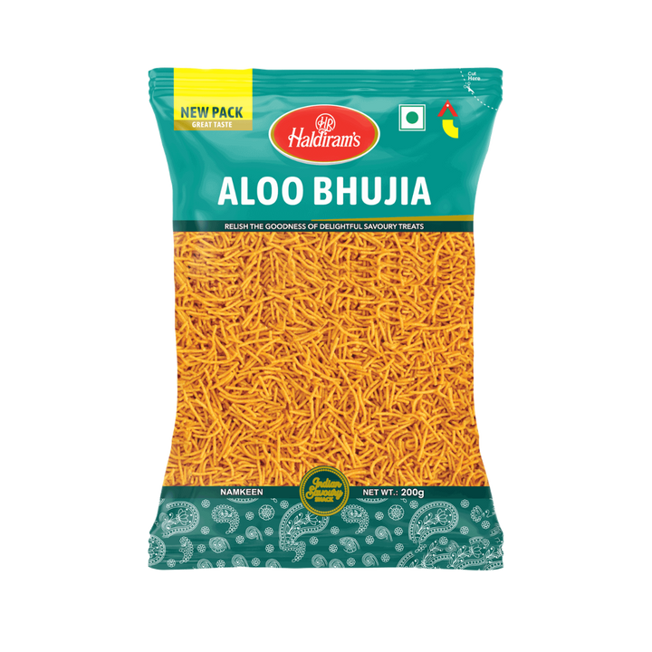
Products to be launched in switzerland
Less-Oily Aloo Bhujia
Brand: Haldiram's
Item Name: Less-Oily Aloo Bhujia
Item Weight: 220g
Speciality: Reduced Oil Content, Savory Snack
Diet Type: Veg
Package Weight: 190g (including packaging)
Package Type: Pouch (flexible plastic or recyclable material)

Slide 17
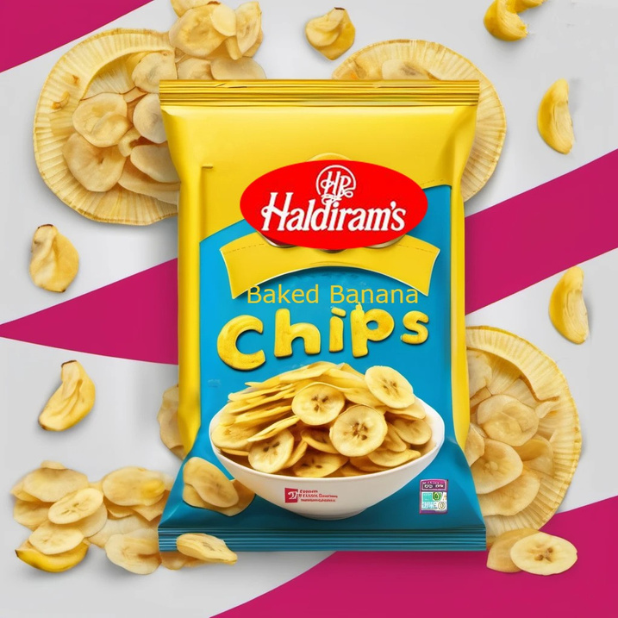
Baked Banana Chips
Brand: Haldiram's
Item Name: Baked Banana Chips
Item Weight: 160g
Speciality: Baked (Healthier Alternative), Natural Sweetness
Diet Type: Veg
Package Weight: 160g (including packaging)
Package Type: Pouch (flexible plastic or recyclable material)

Slide 18

Product Adaptation
Baked Banana Chips:
Focus on the baked version for a healthier image.
Consider offering different flavors like honey-roasted or chocolate-drizzled for a wider range.
Aloo Bhujia:
Offer a less-oily version to cater to health-conscious consumers.
Emphasize the traditional recipe and unique flavors/textures compared to crackers.

Slide 19

Box Volume: 75*35*35 cm^3 = 91,875 cm^3
Protection Space= (20/100) * 91,875
=18,375 cm^3
Total Usable Space= 91,875-18,375
=73,500 cm^3
Aloo Bhujia
Pack Dimension: 21.7 cm *14 cm *4.1 cm
Per Packet Volume= 21.7 *14*4.1 cm^3 =1245.58 cm^3
Total packet in a box= Total Usable space/ per packet volume = 73500/1245.58
=59 Packs
Total Number of Boxes=18 boxes
Total no. packets per Consignment = 59*18 = 1062
Total weight/Consignment = (1,062*220gm)/1000
= 235 kg(Approx.)
Banana Chips
Packet Dimension: 10 cm* 5 cm * 16 cm
Per Packet Volume= 10 * 5 *16cm^3 = 800 cm^3
Box Dimension: 75*35*35
Total packet in a box= Total Usable space/ per packet volume = 73500/800
=91 Packs
Total Number of Boxes=17 boxes
Total no. packets per Consignment = 91*17 = 1,547
Total weight/Consignment = (1,547*160gm)/1000
= 247.52 Kg(Approx.)

Slide 20

Costing Of Aloo Bhujia @ Exchange rate Rs.1= 0.011CHF | Costing Of Aloo Bhujia @ Exchange rate Rs.1= 0.011CHF | Costing Of Aloo Bhujia @ Exchange rate Rs.1= 0.011CHF
Costing Of Aloo Bhujia @ Exchange rate Rs.1= 0.011CHF | Costing Of Aloo Bhujia @ Exchange rate Rs.1= 0.011CHF | Costing Of Aloo Bhujia @ Exchange rate Rs.1= 0.011CHF
Particulars | Amount(INR) | Amount(CHF)
Cost of Aloo Bhujia | ₹ 52.00 | 0.57 CHF
Shipping and Expenses | ₹ 153.72 | 1.69 CHF
Total FOB | ₹ 205.72 | 2.26 CHF
Profit Margin(40%) | ₹ 82.29 | 0.91 CHF
VAT(2.6%) | ₹ 7.49 | 0.08 CHF
Wholeseller Price | ₹ 295.50 | 3.25 CHF
Retailer Mark-Up(30%) | ₹ 88.65 | 0.98 CHF
Selling Price(Including VAT) | ₹ 384.15 | 4.23 CHF
Pricing Strategy
Link To Excel Sheet

Slide 21
 |  | Amount(INR) | Amount(CHF)
Total Packets | 1062 | ₹ 3,13,816.97 | 3,451.99 CHF
Free Packets | 62 | ₹ 18,320.76 | 201.53 CHF
 |  | ₹ 2,95,496.21 | 3,250.46 CHF
Cost of Total Packets |  | ₹ 2,18,474.64 | 2,403.22 CHF
Net Profit |  | ₹ 77,021.57 | 847.24 CHF
Profit % |  | 26% | 26%

Slide 22
Costing Of Banana Chips @ Exchange rate Rs.1= 0.011CHF | Costing Of Banana Chips @ Exchange rate Rs.1= 0.011CHF | Costing Of Banana Chips @ Exchange rate Rs.1= 0.011CHF
Costing Of Banana Chips @ Exchange rate Rs.1= 0.011CHF | Costing Of Banana Chips @ Exchange rate Rs.1= 0.011CHF | Costing Of Banana Chips @ Exchange rate Rs.1= 0.011CHF
Particulars | Amount(INR) | Amount(CHF)
Cost of Banana Chips | ₹ 80.00 | 0.88 CHF
Shipping and Expenses | ₹ 233.17 | 2.56 CHF
Total FOB | ₹ 313.17 | 3.44 CHF
Profit Margin(30%) | ₹ 93.95 | 1.03 CHF
VAT(2.6%) | ₹ 10.59 | 0.12 CHF
Wholeseller Price | ₹ 417.71 | 4.59 CHF
Retailer Mark-Up(30%) | ₹ 125.31 | 1.38 CHF
Selling Price(Including VAT) | ₹ 543.02 | 5.97 CHF

Slide 23
 |  | Amount(INR) | Amount(CHF)
Total Packets | 1547 | ₹ 6,46,191.41 | 7,108.11 CHF
Free Packets | 47 | ₹ 19,632.19 | 215.95 CHF
 |  | ₹ 6,26,559.22 | 6,892.15 CHF
Cost of Total Packets |  | ₹ 4,84,473.99 | 5,329.21 CHF
Net Profit |  | ₹ 1,42,085.23 | 1,562.94 CHF
Profit % |  | 23% | 23%

Slide 24

The two main players in the grocery retail market are Migros and Coop, with a combined market share of around 70%.

Slide 25
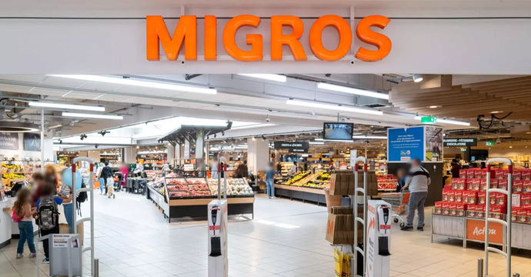


Promotion
Free Sampling: Conduct in-store demonstrations and offer free samples at strategic locations
Social Media Marketing:
Create engaging content showcasing the products, their unique flavors, and potential health benefits.
Target social media ads to demographics interested in healthy snacks and international flavors.
In-Store Advertising:
Partner with Migros and Coop for eye-catching displays and promotional placements near chips and healthy snack sections.
Consider shelf talkers highlighting the unique qualities of Haldiram's products.

Slide 26
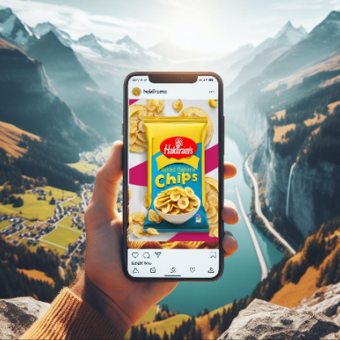
Social media engagement posts
Snacking just got an upgrade!
Fribourg, say hello to your new healthy snack obsession! 🇨🇭✨ Our Baked Banana Chips are made with natural sweetness and are perfect for a guilt-free treat. What's your favorite way to snack? Tell us in the comments below! #Haldirams #Fribourg #HealthySnacks #SnackTime#SnackNaturally#SnackDeliciously
#Snacking_just_got_an_Upgrade!

Slide 27
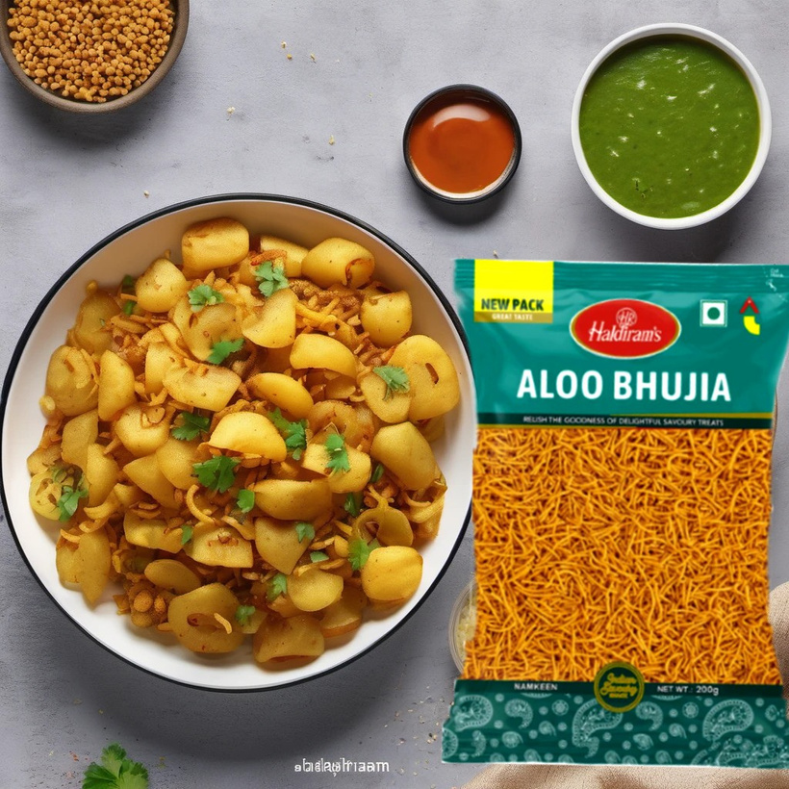
Snacking just got an upgrade!
Fribourg, craving a crunchy companion? Look no further! Our Less-Oily Aloo Bhujia is the perfect guilt-free snack to satisfy your cravings. What are your favorite moments to munch on some Bhujia? Share in the comments! #Haldirams #Fribourg #SnackTime #AlooBhujia
#Snacking_just_got_an_Upgrade!

Slide 28
Conclusion
This project is all about introducing Fribourg to the vibrant flavors of India with Haldiram's exciting snack range. We're confident that both the Less-Oily Aloo Bhujia and Baked Banana Chips will be a hit with health-conscious consumers seeking delicious and unique options.
Our strategic partnership with Migros and Coop guarantees extensive distribution, putting Haldiram's within easy reach for Fribourg residents. We've also crafted captivating social media campaigns designed to engage the target audience and build excitement around the launch.

Slide 29



Thank you!

